Slide 1
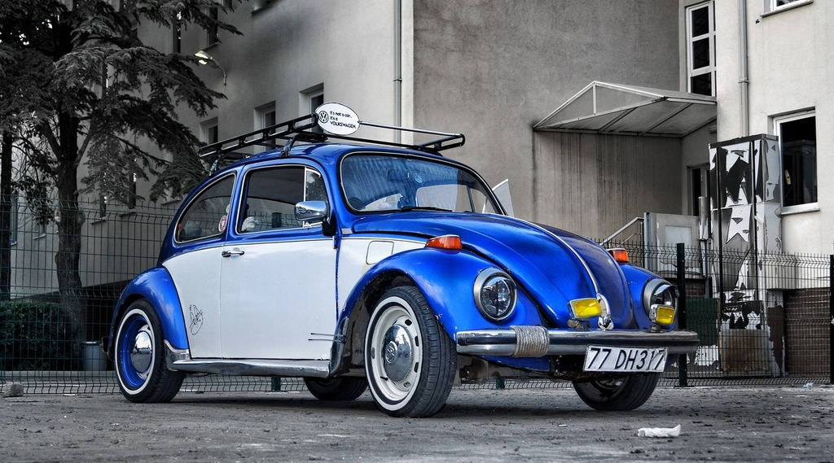
Machine Learning Joyride
Data Maverick team deep dive –
Riicha Mohan
Deepa Karnani
Ira Buchberger
Roderick Jean

Slide 2
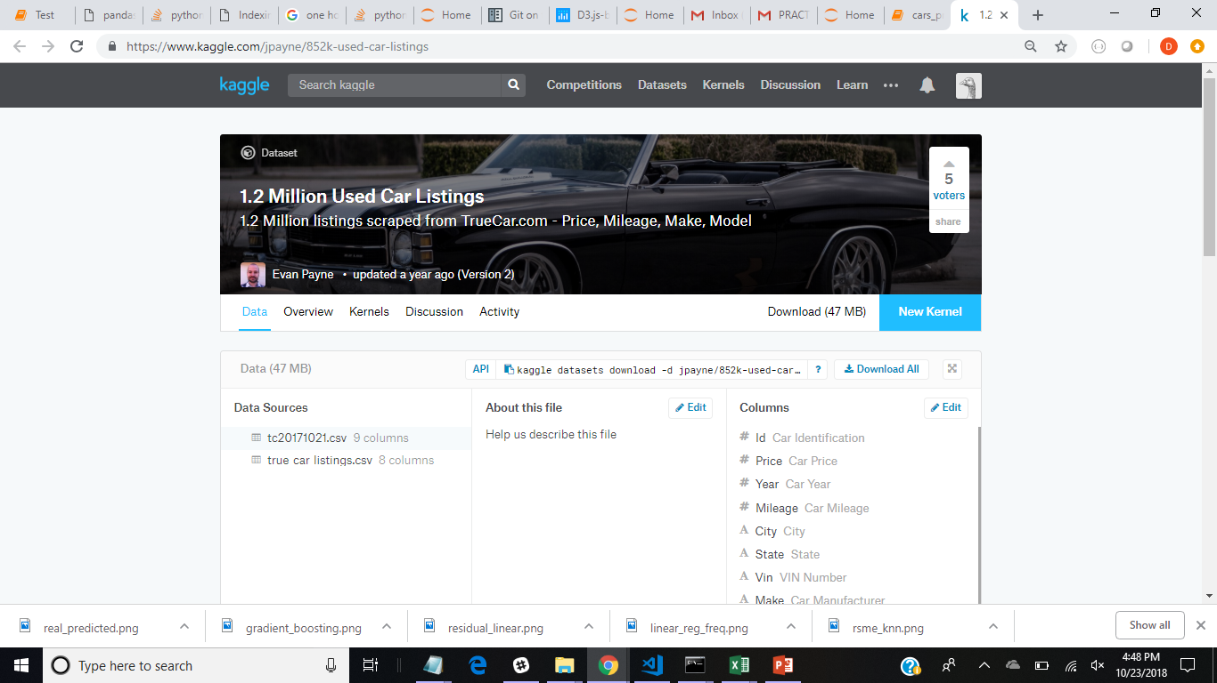
Data Source

Slide 3
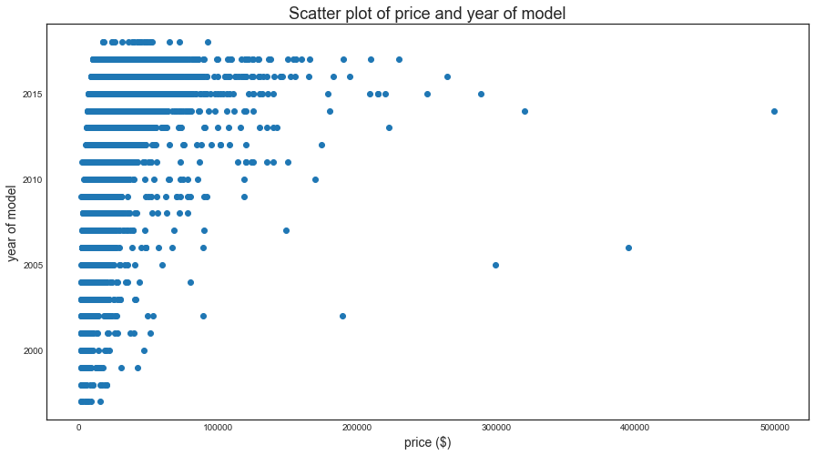
Scatter Plot of Price and Year of Model
 | Price | Year | Mileage | City | State | Vin | Make | Model
0 | 8995 | 2014 | 35725 | El Paso | TX | 19VDE2E53EE000083 | Acura | ILX6-Speed
1 | 10888 | 2013 | 19606 | Long Island City | NY | 19VDE1F52DE012636 | Acura | ILX5-Speed
2 | 8995 | 2013 | 48851 | El Paso | TX | 19VDE2E52DE000025 | Acura | ILX6-Speed
3 | 10999 | 2014 | 39922 | Windsor | CO | 19VDE1F71EE003817 | Acura | ILX5-Speed
4 | 14799 | 2016 | 22142 | Lindon | UT | 19UDE2F32GA001284 | Acura | ILXAutomatic

Slide 4
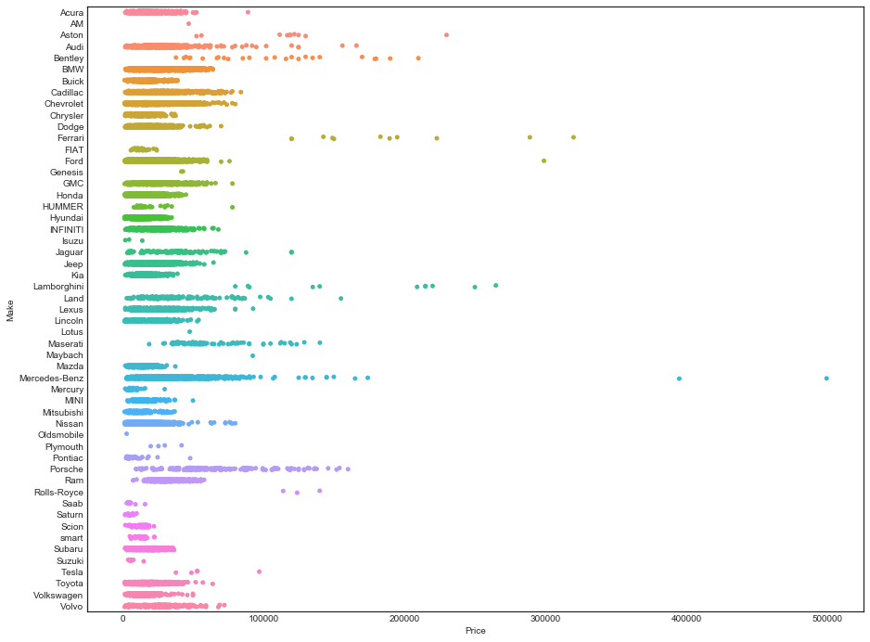
Willing to pay the right price?

Slide 5
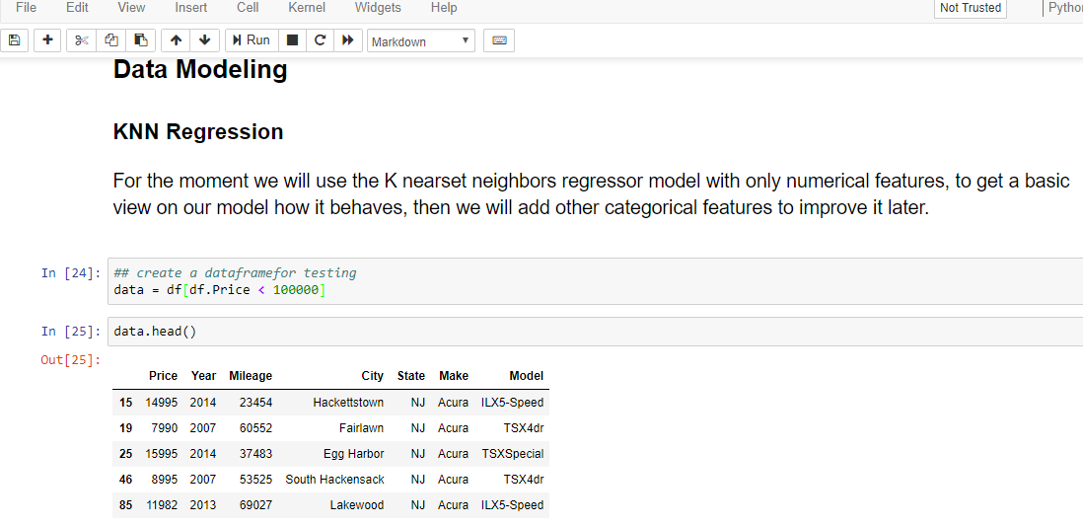
Machine Learning our model

Slide 6
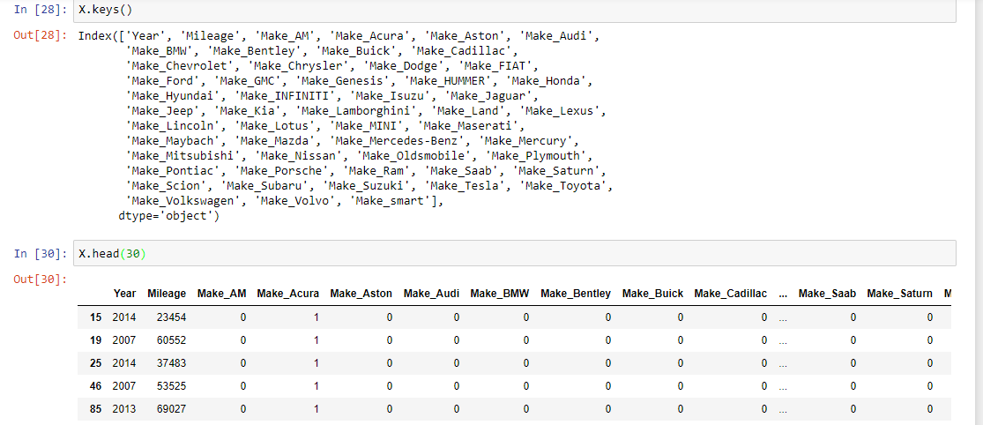
One hot encoding!

Slide 7
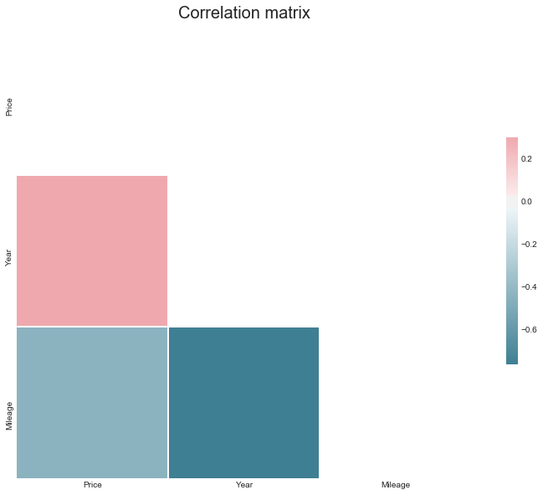
Correlation Matrix – Fits Machine Learning

Slide 8
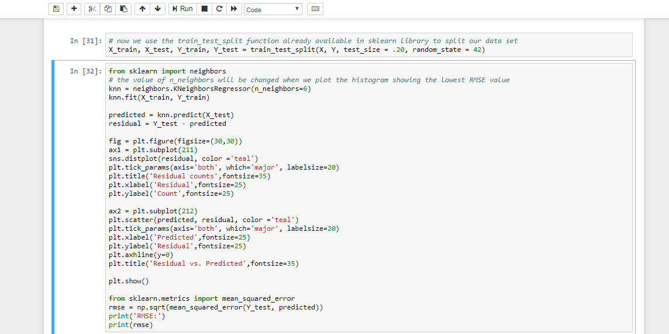
Code

Slide 9
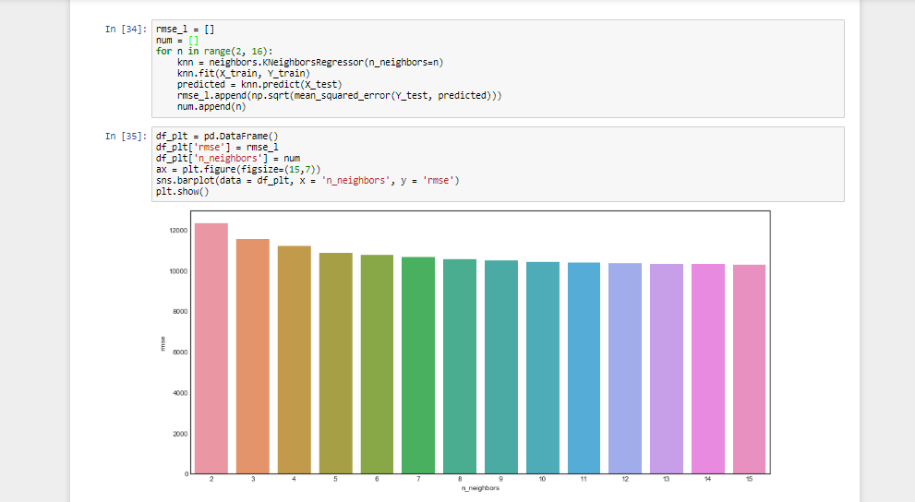
kNN

Slide 10
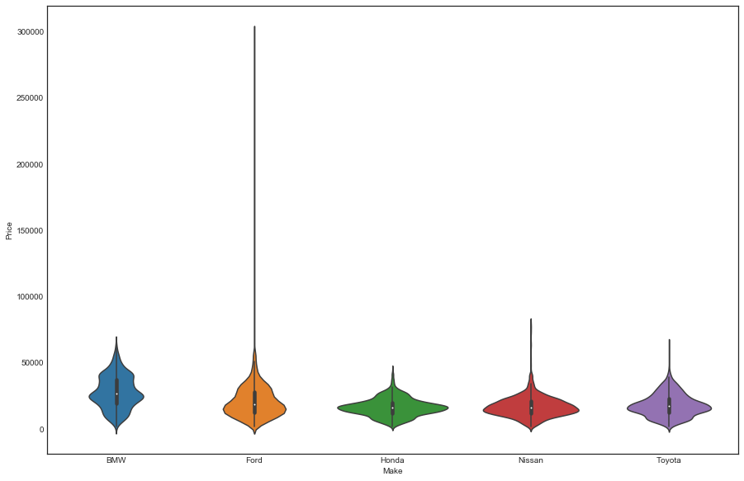
BMW & Ford are apart from Japanese

Slide 11
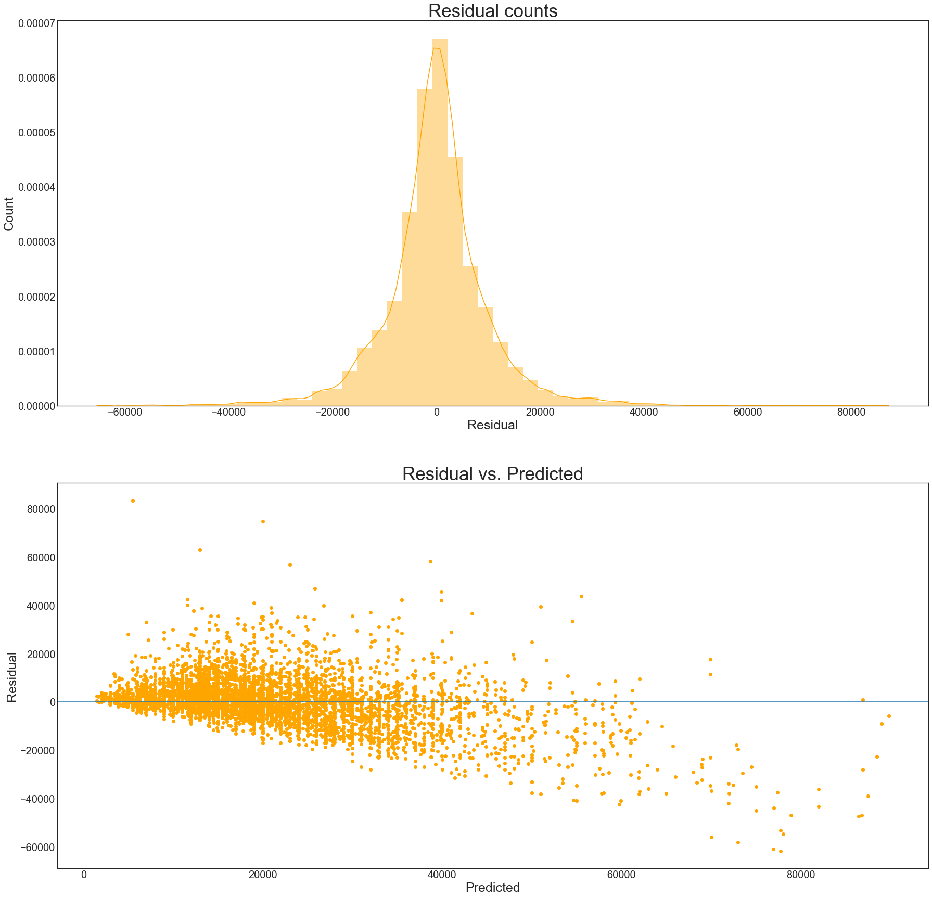
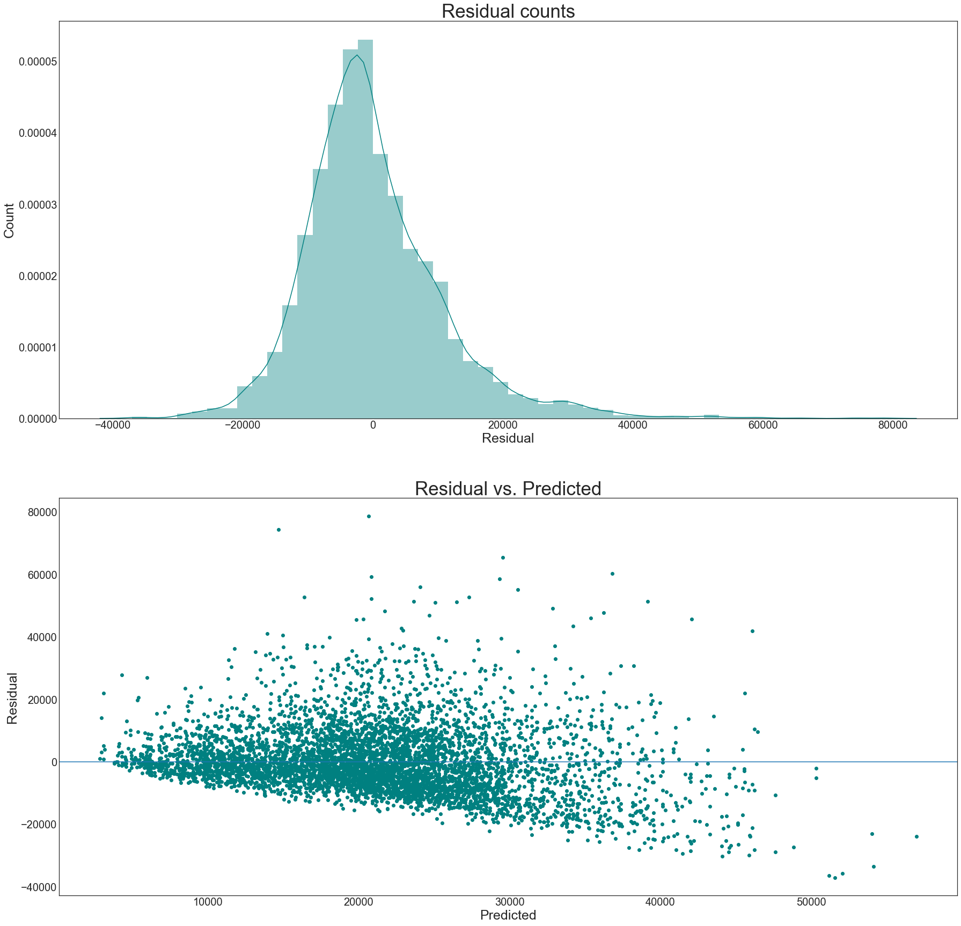
Decision Tree Vs Linear Regression

Slide 12
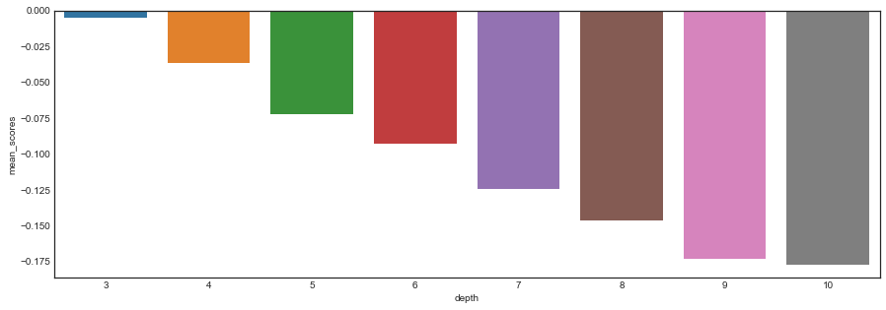
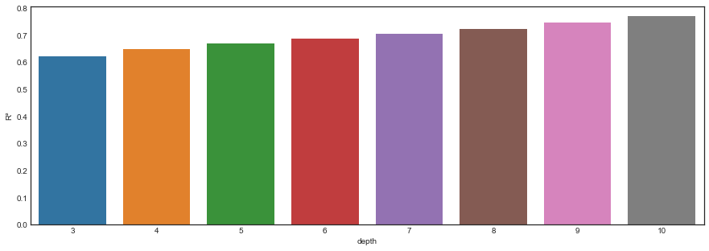
Depth vs Mean Scores
Depth and R²

Slide 13
Gradient Boosting
Boosting is a machine learning ensemble meta-algorithm for primarily reducing bias, and also variance in supervised learning, and a family of machine learning algorithms which convert weak learners to strong ones. Boosting is based on the question posed by Kearns and Valiant (1988, 1989):
Can a set of weak learners create a single strong learner? A weak learner is defined to be a classifier which is only slightly correlated with the true classification (it can label examples better than random guessing). In contrast, a strong learner is a classifier that is arbitrarily well-correlated with the true classification. ~ WikiPedia) Let's see if boosting can improve our scores.

Slide 14
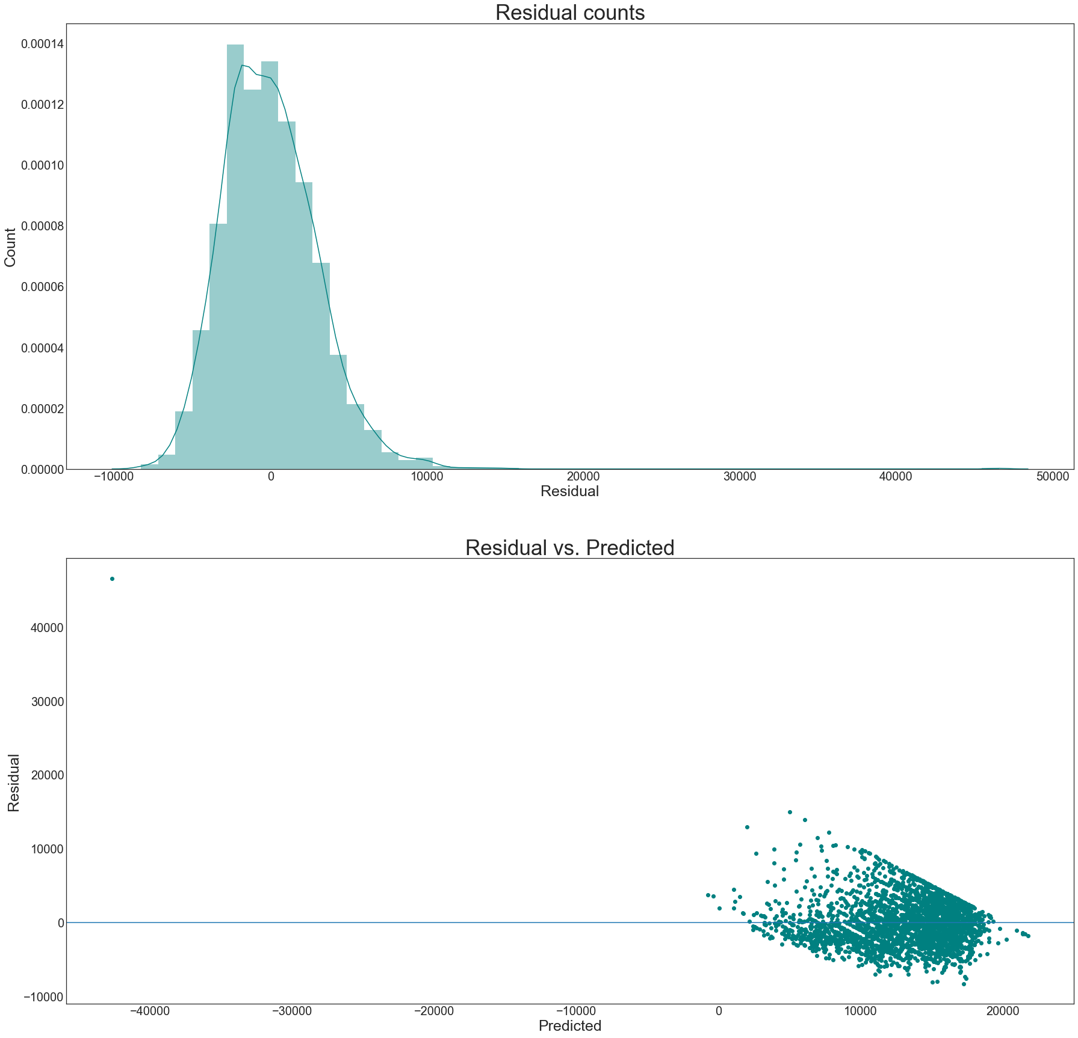
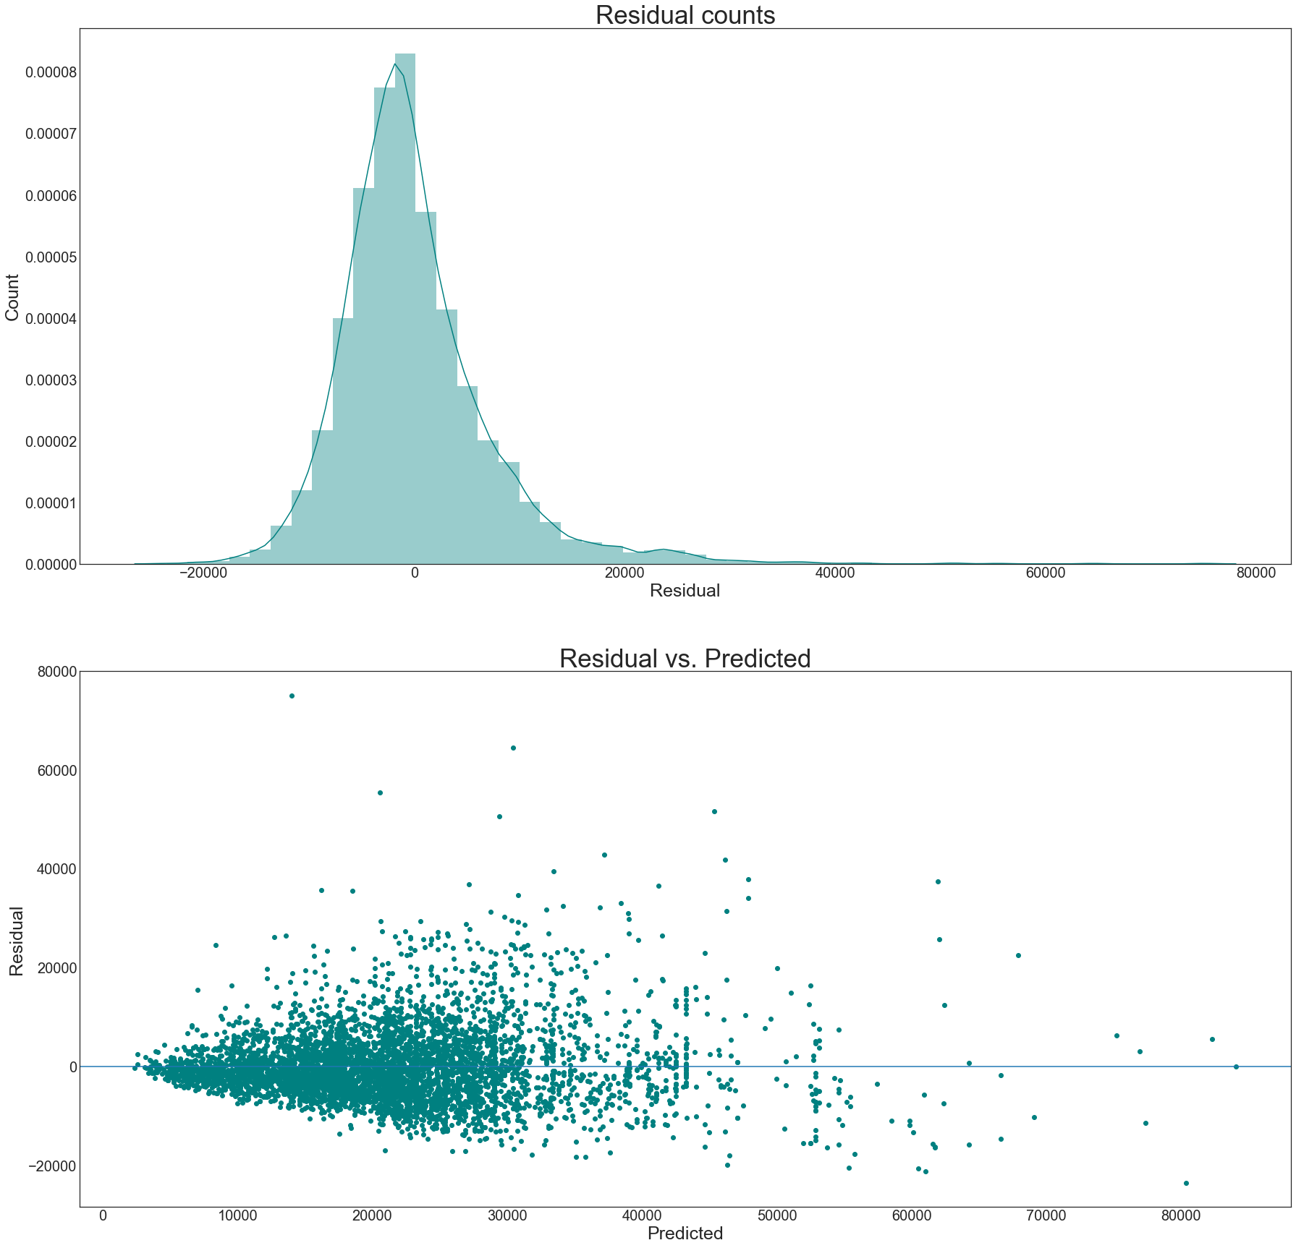
Before and after Gradient Boosting
Cross Validation Scores: [ 0.13138574 0.2287211 -0.07146873 -0.01487822 0.1965145 -0.15226534
-0.35215761 0.26947998 0.28404311 0.15576505 0.14053602 0.02408153]
Mean Score: 0.06997976114267189 RMSE: 7221.055204912808

Slide 15
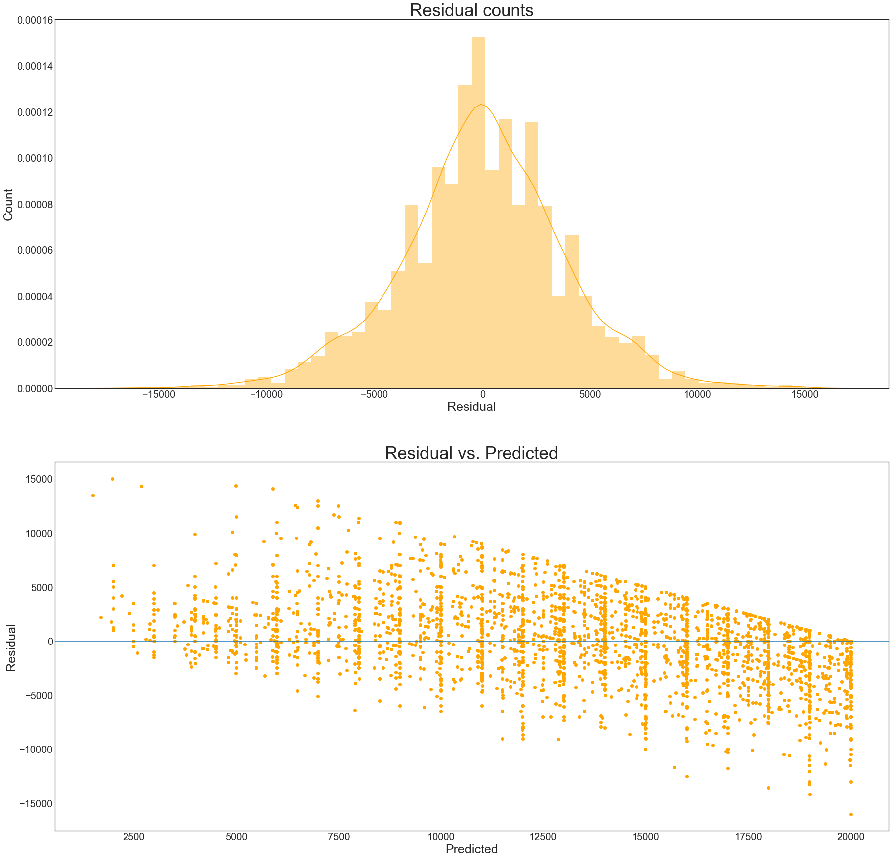
kNN application delivers lower rsme

Slide 16
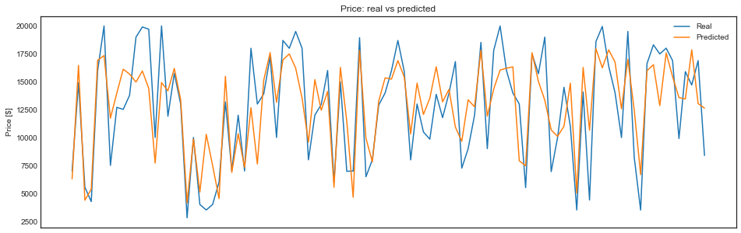
Trained and tested..

Slide 17
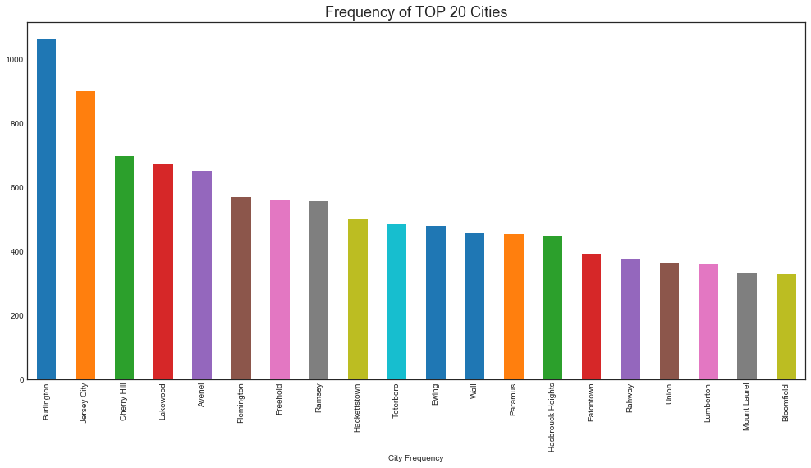
NJ’s top 20 cities with Cars inventory distribution

Slide 18
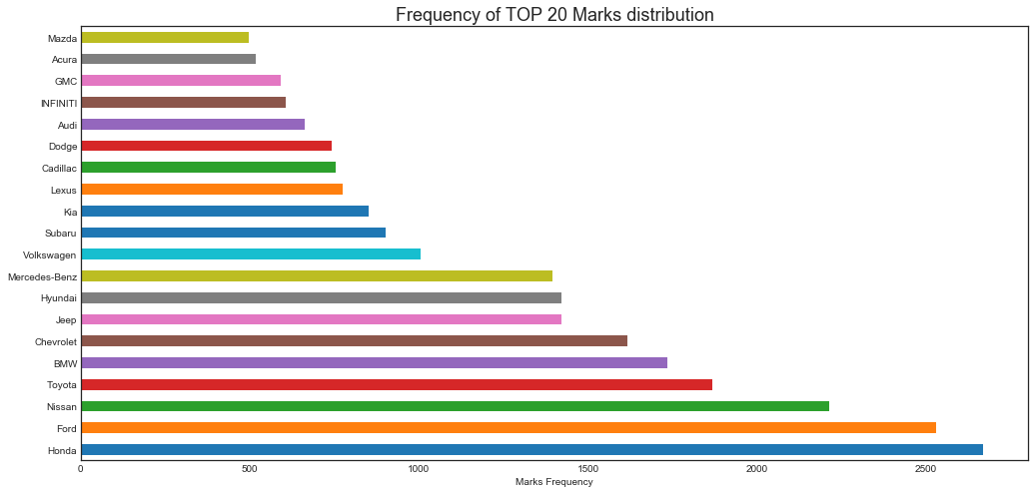
Top 20 cars!

Slide 19
RMSE Scores
Model | Variance Score | RMSE
KNN | 0.56 | 37709.67
Multiple Linear Regression | 0.62 | 34865.07
Gradient Boosting | 0.80 | 25176.16
Decision Tree | 0.63 | 34551.17

Slide 20
Acknowledgements and Future Work:
DataMavericks Team
Ashish Nachane
Aiyana Liz Mathew
Ruchi Chandra
Mario Aburto
Including Fuel type as parameter for evaluation
Cars Images identification via Visual AI
Geo-mapping inventory based on user location and search parameters

Slide 21
References:
https://github.com/chrisjameskirkham/car-mpg/blob/master/param_search.py
https://evantamle.wordpress.com/2015/07/13/regression-analysis-with-python/
http://scikit-learn.org/stable/modules/linear_model.html#polynomial-regression-extending-linear-models-with-basis-functions
https://www.analyticsvidhya.com/blog/2016/01/complete-tutorial-ridge-lasso-regression-python/
https://www.kaggle.com/devanshbesain/exploration-and-analysis-auto-mpg
https://www.crockford.com/javascript/
carfolio.com
https://stackoverflow.com/questions/42196589/any-way-to-get-mappings-of-a-label-encoder-in-python-pandas
https://plot.ly/javascript/scatter-plots-on-maps/
https://www.kaggle.com/jpayne/852k-used-car-listings

